Slide 1
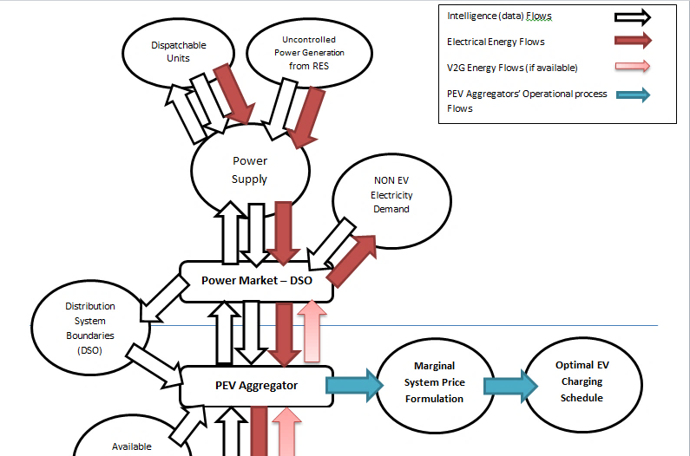
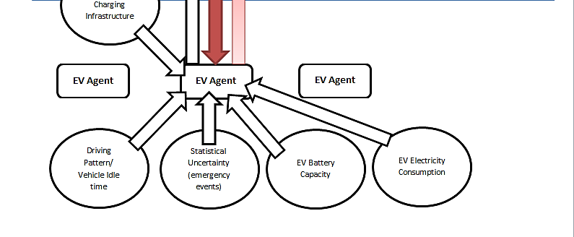
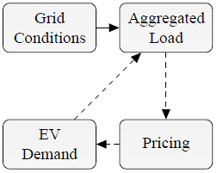
EV Charging Strategies and the role of PEV Aggregators
Authors:
A. Perellis¹, D. Mezartasoglou², C. Stambolis ³
Institute of Energy for SE Europe (IENE)
3, A. Soutsou str, 106 71-Athens, tel.:0030 210-3628457, fax: 0030 210-3646144
e-mail: info@iene.gr, website: www.iene.eu
¹Research Associate IENE, ² Research Coordinator IENE, ³ Executive Director IENE
Introduction
With global power market aiming to achieve high penetration of RES to reach the COP21 climate goals, the electrification of the transportation sector has been an important piece to the strategy for Climate Change mitigation. The development and the penetration of electric mobility in the Motor Vehicle market has initiated a transformation of the power generation and distribution systems world wide. The large scale integration of uncontrollable renewable energy resources (RES), deployed to facilitate plugin electric vehicles (PEVs) with clean energy, such as wind and solar, which are directly depended on local weather conditions, would add uncertainty in keeping the real time balance between electricity supply and electricity demand. The electricity market in order to facilitate the newly introduced and prospect PEV charging loads, while balancing the power system, would require demand response from charging operations and consequently increased flexibility of PEV charging loads. Such requirements, have prompted the emergence of new market entities, PEV Aggregators, which aim in facilitating PEV charging services, while they participate actively in the electricity market via complex interactions with other market entities.
PEV Smart Charging approaches
There are two approaches in performing demand response through PEV smart charging:
The centralized approach is focusing on aggregation of charging operations, where emerging market entities, PEV Aggregators, manage temporally and spatially the charging load of a large EV fleet with advanced optimization models which are aiming in improving the quality of charging services, providing the state of charge (SOC) required by the user , while they provide ancillary services to the grid by participating in the day-ahead, intraday and balancing electricity market.
The decentralized approach is focusing on individual scheduling and demand response of EV agents. Such approach is only effective when the intelligence is distributed among the power system components with the integration of smart metering and other automated processes chosen by each electric vehicle-charging infrastructure system by reflecting the condition of the local power system [2].
Table 1 Identified Advantages and Disadvantages of Centralized and Decentralized Smart PEV charging control
PEV charging control models
 | Centralized | Decentralized
Advantages | Strategic energy management scheduling through optimization schemes aiming in (a) reducing carbon intensity for electricity, (b) reduce the marginal cost of electricity or (c) minimize the saturation of transformers and power distribution branches | Simple way of Scheduling PEV charging operations performed by the consumer
 | Ancillary services provision (frequency control, load balance, spinning reserves through V2G services) | Automated ancillary services provision (frequency control, load balance services)
 | Highly adaptable participation in power market
 | Simple way of control
 | Strategic PEV discharging utilizing V2G capabilities
Disadvantages | Optimization schemes with high complexity with numerous iterations - (high demand for computational resources) | Requires smart metering and advanced power automations
 |  | Complex control (infrastructure)
 | Advanced communicational infrastructure (data sharing) for real time operations | Low participation in power market
 |  | No strategic energy management
Figure 1 A PEV Aggregator’s Operational framework and its relation to other Market Entities (Illustrated as a flowchart)
PEV Aggregator’s Socioeconomic Role
PEV Aggregators should pass fiscal compensation on the EV agents for:
Temporal adaptability of the required State of Charge (SOC) of each PEV user
Plug in availability – responsive EV agents
Battery degradation due to V2G discharge
High Depth of Discharge (DOD) availability of PEV agents for V2G discharge proportional to the available battery capacity
PEV Aggregators should be expecting to be compensated by the power market based on their ancillary service provision for:
Carbon intensity reduction of electricity (PEV charging during peak power generation from RES)
Reduction of the marginal price of electricity through temporal load allocation (peak shaving, valley filling)
Peak load reduction, by either temporal allocation PEV charging loads to off-peak charging periods or by performing peak shaving by utilizing V2G capabilities
PEV Aggregators by influencing the price for EV charging, they also affect the penetration of EV in the Motor Vehicle market. One of the most important benefits of EVs is their low operational cost due to the low prices of electricity in comparison to oil products consumed by conventional ICE vehicles. Therefore, by influencing the EV charging price PEV aggregators are charged with the important role of participating in the societal welfare maximization induced by the emergence of EVs. [4]
Figure 2 Pricing-based control mechanism for social welfare maximization [4]
PEV Aggregators Participate in Power Market
Power Market participation: In order to participate in the in the day-ahead power market, it is important for an Aggregator to make an appropriate contract with each vehicle owner. After mapping the vehicle stock it facilitates, and record vehicle’s technical characteristics and user behavior, the aggregator must determine the PEV charging load by performing daily demand forecasts based on historical data and user’s preferences, while considering profit maximization [1] and carbon footprint minimization objectives (these can be achieved by performing optimization processes aiming at strategic electricity price minimization and green house gas emissions minimization). Once the PEV charging demand profile is formulated it must be approved by the DSO ensuring that it will not compromise the safe operation of the distribution network. On the aftermath of this procedure the Aggregator will proceed to commence power purchase bids directly in the day-ahead market or through an electricity utility [3]. The PEV charging demand profile is expected to be adapted to match the requirements, if any, of the Transmission System Operator to avoid problems in the transmission network.
Grid regulation/ancillary services: In order to provide ancillary services, Furthermore, PEV Aggregators control in real time the charging set-points of each connected PEV, in order to meet the commitments made in the electricity market. Consequently, they can bid in the intra-day and balancing market to provide balancing services, occurring due to unexpected demand or cost-effective supply unavailability.
Conclusion and Suggestion
The emergence of PEV aggregators has been crucial for the introduction of EVs in the Motor Vehicle Market. Furthermore in the new framework charging are transformed to facilitate high charging loads of 10kW to 30kW per charging operation while securing the functionality of the components of the power system. PEV Aggregators fill an important gap in the market by making each EV a demand response unit for ancillary service provision and in some case a Virtual Power Plant acting as a spinning reserve to facilitate imbalances in the power market. Furthermore to realize the Socioeconomic Role of PEV Aggregators, it is important to actively monitor the technological evolution of EVs and evaluate cost-benefit interactions between Aggregators and other market entities ensuring their incorporation to operational framework of PEV charging industry.
References
[1] Sekyung Han, Student Member, IEEE, Soohee Han, Member, IEEE, and Kaoru Sezaki, Member, IEEE «Development of an Optimal Vehicle-to-Grid Aggregator for Frequency Regulation», IEEE TRANSACTIONS ON SMART GRID, VOL. 1, NO. 1, JUNE 2010
[2] A multi-agent based scheduling algorithm for adaptive electric vehicles charging Erotokritos Xydas, Charalampos Marmaras, Liana M. Cipcigan, Applied Energy 177 (2016) 354–365
[3] Garcia-Villalobos, Javier & Zamora, I & San Martín, J.I. & Asensio, F.J. & Aperribay, V. (2014). Plug-in electric vehicles in electric distribution networks: A review of smart charging approaches. Renewable and Sustainable Energy Reviews. 38. 717-731. 10.1016/j.rser.2014.07.040.
[4] Bayram, Islam & Tajer, Ali & Abdallah, Mohamed & Qaraqe, Khalid. (2015). Capacity Planning Frameworks for Electric Vehicle Charging Stations with Multi-Class Customers. IEEE Transactions on Smart Grid. 6. 10.1109/TSG.2015.2406532.

